Slide 1
Business in a Box

Slide 2




Business in a Box
Notes:
Life expect us to make measureable progress in reasonable time.
Success is a numbers game.
We demand it of our children.
One of the most motivating factor is progress.

Slide 3
Business in a Box
Notes:
Life expect us to make measureable progress in reasonable time.
Success is a numbers game.
We demand it of our children.
One of the most motivating factor is progress.

Slide 4

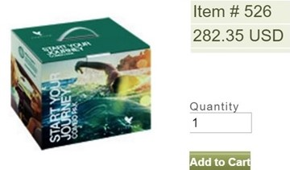

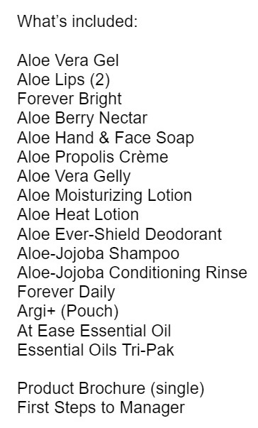
1 START YOUR JOURNEY
= $240
Join Free
15%
Assistant Supervisor 2cc
A/Sup FBO
Next Purchase
18 Items
35%
Business in a Box
Notes:
Life expect us to make measureable progress in reasonable time.
Success is a numbers game.
We demand it of our children.
One of the most motivating factor is progress.

Slide 5

1 START YOUR JOURNEY
= $240
Assistant Supervisor 2cc
Join Free
15%
A/Sup FBO
Next Purchase
35%
Notes:
Life expect us to make measureable progress in reasonable time.
Success is a numbers game.
We demand it of our children.
One of the most motivating factor is progress.

Slide 6
Slide title template

Slide 7
TradingView Training Videos

